Slide 1
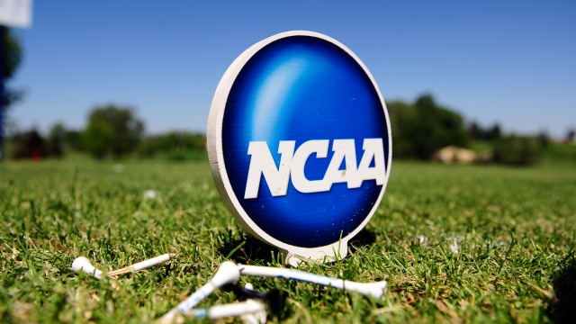
College Golf and Recruiting
Brad Sparling
President and Founder/Coach and Mentor
Mark MacDonald
Coach and Mentor
www.playgolfincollege.com
Presentation to OHSAA Golf Coaches

Slide 2
Our Background
Brad Sparling
Former Men’s and Women’s Golf Coach at Duke University. Former Men’s Associate Head Coach at The Ohio State University. Founded Play Golf In College 8 years ago.
  Coached 2 NCAA Championship Women’s Teams at Duke University
  Coached 14 Division 1 NCAA All-Americans
  Coached 2 Division 1 National Players of the Year and 1 NCAA Individual Champion
  Recruited (2) Top 5 National Recruiting Classes while Duke Men’s Coach
  Worked with/Coached (3) Ohio Division 1 State High School Boys Individual Champions, (2) Ohio Division 1 State High School Individual Girls Champions, (2) Ohio Division 2 State High School Individual Boys Champions, (1) Ohio Division 2 State High School Girls Individual Champions.
  Over 95% of PGIC players have received offers to play golf in college
  Played Golf at Vanderbilt and Guilford College where he received a Degree in Economics

Slide 3
Our Background
Mark MacDonald
- Former Assistant Men’s Golf Coach at Miami University
  Played Golf at Miami University
  2x Academic All American with a degree in Integrated Mathematics
  Played Professionally for two years on various golf tours
  Miami University - Assistant Men’s Coach for 2 years when Miami won their first MAC Championship in over 15 years
  In charge of Southwest Ohio, Indiana and Kentucky for Play Golf In College

Slide 4
What We Do
Help players and families navigate the college recruiting process
  Help players develop a Recruiting Package
  Help players and families identify an appropriate list of prospective schools
  Mentor players as they communicate with coaches
  Arrange Visits to Schools
  Help players prepare for College Visits
  Act as a referral source for college coaches
  Help players determine if a school is a good fit
  Mentor players as they negotiate scholarship offers
  Help families understand NCAA Rules
  Help players develop Tournament Schedules

Slide 5
What We Do
Help players develop their games
  Full Swing Instruction utilizing TrackMan, 4D Motion Analysis, Boditrak
  Short Game and Putting Instruction
  Regular Playing Lessons
  Course Management using the latest Statistical Target Models
  How to Practice Effectively/What to Practice
  Strokes Gained Analysis
  Mental Game and Sports Performance Journals
  Off Season Seminars on various topics such as Leadership, Etiquette, Personal Development etc.
  Tournament Travel Program - we replicate the College Golf experience
  WE HELP OUR PLAYERS LEARN HOW TO PLAY THE GAME AND SCORE

Slide 6
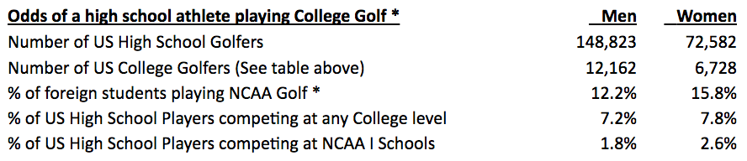
Odds of a High School Golfer Playing in College
http://www.scholarshipstats.com/golf.htm

Slide 7
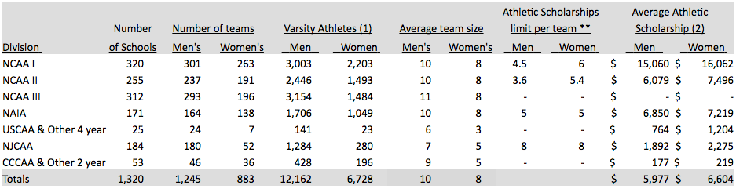
Overview of College Golf
There are many schools/options for your talented golfer.
http://www.scholarshipstats.com/golf.htm

Slide 8
What are College Coaches Looking for in a Prospective Golfer?
Great Students
Good Athletes that have played multiple sports
High Character Kids
Work Ethic/ How they practice and handle adversity
Players that value Team
Players that hit the ball a long way
Players that have solid fundamentals
Players that will continue to improve
Consistent scores that translate to college golf
Potential to go low

Slide 9
NCAA Rules
Important Things to Remember
  A prospective golfer may communicate directly with a college coach at any time
  A prospective golfer can communicate with a college coach at any age if that communication takes place while on a visit to campus
  A D1 or D2 coach is not allowed to communicate with a prospective athlete or family member during a tournament. That coach IS allowed to communicate with you. Or with us.
  A D1 or D2 coach can send a questionnaire and general school information to a prospect beginning in 9th grade

Slide 10
NCAA Rules
  A D1 coach cannot communicate with written correspondence until September 1 of the start of the prospects junior year in high school.
  A D1 coach cannot call a prospect until September 1 of the start of the prospects junior year in high school. So if a prospect who is a sophomore in high school calls and leaves a message- the coach is not allowed to call them back at that time.
  D3 coaches are allowed much greater leeway in regards to how and when they communicate with prospects

Slide 11
The Recruiting Process
8th-9th Grade
  Player initiates communication with Coach
  Coach evaluates player during a tournament
  Player puts together Recruiting Package
10th Grade
  Player initiates communication with coach, and continues to update coach with swing videos, tournament results and schedules
  Coach evaluates progress in players game
  Player registers with the NCAA Eligibility Center (Formerly Clearinghouse)
  Player makes unofficial visits to prospective schools
11th Grade
  Player and Coach can communicate directly for the first time.
  Player continues to take unofficial visits to schools
  Player takes ACT/SAT
  Coach makes verbal offer to player.
  Player accepts verbal offer

Slide 12
Communicating with College Coaches
It is critical that a prospective athlete starts communicating with coaches as soon as possible.
  Even if the high school golfer doesn’t currently have the scores to warrant an offer, he or she must get their name out there and start developing a relationship with coaches.
The content of the communication is important
  Make sure the message is succinct.
  Show your passion for the game and your capacity for hard work.
  Make sure the grammar is correct!

Slide 13
Unofficial Visits to Prospective Schools
An Unofficial Visit is one where the prospective student-athlete pays his or her own expenses for the trip. There are very few rules on when this can take place.
  In this day and age, your success in obtaining an offer from a school is much higher if you make visits to see coaches on campus.
  So encourage your players to visit schools and meet coaches.
  It’s ultimately all about finding the right fit

Slide 14
Verbal Offers
When can the coach make them?
  A college coach can make a verbal scholarship offer at any point in time.
  An official offer can only be made in writing during the prospects senior year of high school
When do they typically occur?
  Offers are being made earlier every year. The best golfers can receive them in 8th grade or even earlier.
  Verbal offers for nationally ranked players most often occur in their freshman or sophomore years of high school
  Majority of offers occur during a prospects junior year of high school or the summer following the junior year.
How long are offers typically good for?
  That depends on the coach and school. Most coaches set a time limit on the offer.
The goal of a college coach is to get the best talent for the least amount of money.

Slide 15
Verbal and Binding Commitments
A prospective athlete can make a verbal commitment to attend a school and/or accept a scholarship offer at any point in time. This can be done through verbal or written communication to the coach. It is NON-BINDING on both parties.
A BINDING commitment on both parties happens during the National Letter of Intent signing period. For NCAA prospects, there are two signing periods.
  Early Signing period happens in early November of the prospects senior year
  Regular Signing period happens in April of the prospects senior year

Slide 16
Importance of Tournament Scheduling
The Reality
  Most College Coaches do not put much emphasis on what a player shoots in high school tournaments. The courses aren’t similar to what they play in college. Two exceptions - very low scores or very good finishes at State Tournaments.
  Ohio High School Golfers have a very short window of opportunity to play tournament golf outside of high school season, due to our climate, availability of tournaments and the rules of high school golf.
  Strength of Tournament Scheduling and number of tournaments played becomes very important for the junior golfer living in Ohio.

Slide 17
What can YOU do to Help Your Players?
Encourage them to start the process early and to seek qualified help
Stress the importance of academics
Stress the importance of fitness and hitting the ball a long way
Help them identify appropriate junior tournaments to play in
Communicate scores and important info using social media

Slide 18
What can YOU do to Help Your Players?
Develop a web site with pertinent information on your team and your high school schedule/results
Act as a referral source when college coaches call you for information on your player
Help your player take ownership of their games
College coaches typically do not want to hear directly from a high school coach or have them make a visit to campus with their high school players. College coaches want to get to know the player.
Reach out to us if you have any questions regarding your player, his or her future potential, NCAA rules questions, what tournaments to play in, etc. We are here to help you help your player.

Slide 19
Question and Answer Session

Slide 20
Contact Information
Brad Sparling
Mark MacDonald
coachsparling@gmail.com
614-787-2438
markdmacd@gmail.com
614-563-8421
www.playgolfincollege.com

